Slide 1
T = Take Notes
I = Interact with your notes
P = Practice with plenty of repetition
S = Self-test

Slide 2
Chapter 12 Section 1: Types of Mixtures

Slide 3
Essential questions
What are the parts of a solution?
What does “like dissolves like” mean?
What is the difference in the way molecular and ionic substances dissolve?
How is conductivity different for NaCl and MgCl₂?

Slide 4
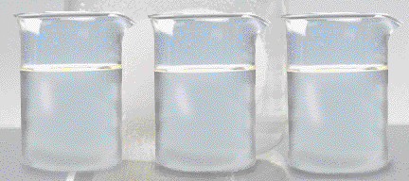
Solutions
Why does a raw egg swell or shrink when placed in different solutions?
Notes:
To play the movies and simulations included, view the presentation in Slide Show Mode.

Slide 5
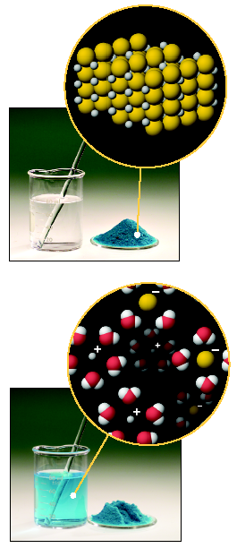
What is a solution?
A solution is a _______________ mixture of 2 or more substances in a single phase.
One constituent is usually regarded as the SOLVENT and the others as SOLUTES.

Slide 6
Parts of a Solution
SOLUTE – the part of a solution that is being dissolved (usually the lesser amount)
SOLVENT – the part of a solution that dissolves the solute (usually the greater amount)
Solute + Solvent = Solution
Solute | Solvent | Example
solid | solid
solid | liquid
gas | solid
liquid | liquid
gas | liquid
gas | gas

Slide 7
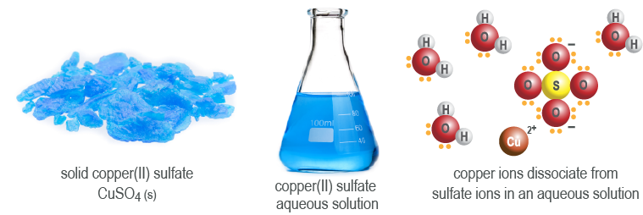
Solutes and solvents
The solvent is the substance that makes up the majority of the solution. As shown below, the copper(II) sulfate solution uses water as the solvent.
The solute, copper(II) sulfate, is the dissolved substance in the solution.

Slide 8
Processes involve in Solution
Consider the solution process taking place in three distinct steps:
1. separation of solvent molecules
2. separation of solute molecules
3. mixing of solvent and solute molecules
or rate of solvation

Slide 9
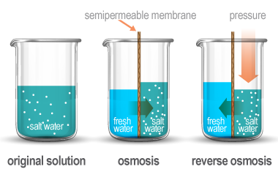
Solution separation techniques
Osmosis is the tendency of a solution to evenly distribute solutes within the solvent, where the solvent will move to areas of high solute concentration.
Reverse osmosis is a method used to purify water by using pressure to force water through a semipermeable membrane towards lower solute concentration.

Slide 10
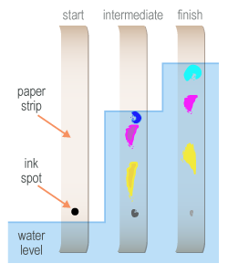
Solution separation techniques
Desalination is the process of using reverse osmosis to convert sea water into fresh water.
Chromatography is a solution separation technique where solutes pass through a medium at different rates

Slide 11
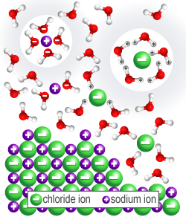
The dissolving process
The solution formation process where a solute is dissolved by a solvent is also called dissolution.
When a water molecule contacts an ion, the particles transfer energy which causes the ions in the salt crystal to separate in a process called dissociation.

Slide 12
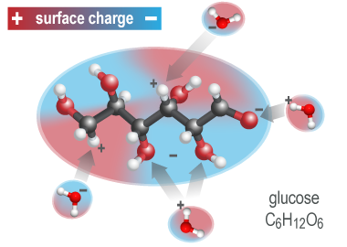
Solvation
Solvation is the process where a solvent surrounds solute particles.
Solvation of a salt in water is called hydration because water is the solvent.
Glucose molecules have regions of positive and negative charge.
Solvation occurs when glucose is mixed with water because the charged areas attract many water molecules.

Slide 13
Factors that affect the
rate of solvation
Agitating the mixture
Increasing the surface area of the solute
3. Increasing the temperature of the solvent

Slide 14
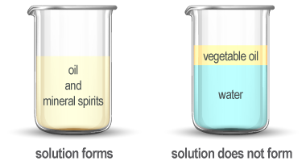
Like dissolves like
Polar solvents dissolve polar solutes, and non-polar solvents dissolve non-polar solutes.
Polar and nonpolar substances are said to be immiscible because they are unable to mix and form a solution.
Oil molecules are nonpolar and so are mineral spirits. This combination is miscible.

Slide 15
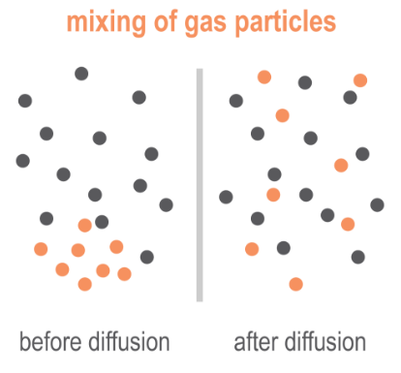
Solids and gases in solutions
Alloys, like steel, are metal solutions in which iron is the solvent and elements such as carbon, nickel, and chromium are solutes.
Gas phase solutions form by diffusion where gas particles collide with one another and mix randomly until all gas particles are evenly distributed in their container.

Slide 16
Electrolyte solutions
An electrolyte is a solute that can conduct electricity when it is dissolved in an aqueous solution.
Sodium chloride dissociates into exactly two individual ions: one cation and one anion.
Magnesium chloride (MgCl₂) is an example of a salt that dissociates into three ions.
Conductivity is a measure of the amount of dissolved ions present in solution.

Slide 17
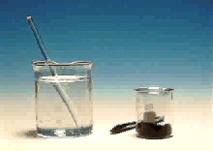
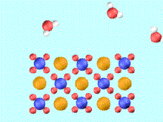
IONIC COMPOUNDS Compounds in Aqueous Solution
Many reactions involve ionic compounds, especially reactions in water — aqueous solutions.
KMnO₄ in water
K⁺(aq) + MnO₄⁻(aq)
Notes:
To play the movies and simulations included, view the presentation in Slide Show Mode.

Slide 18
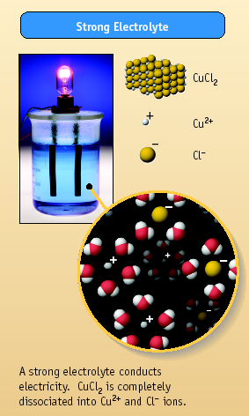
Aqueous Solutions
How do we know ions are present in aqueous solutions?
The solutions _________________________
They are called ELECTROLYTES
HCl, MgCl₂, and NaCl are strong electrolytes. They dissociate completely (or nearly so) into ions.

Slide 19
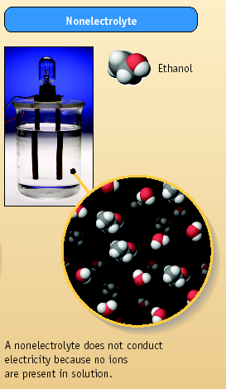
Aqueous Solutions
Some compounds dissolve in water but do not conduct electricity. They are called nonelectrolytes.
Examples include:
sugar
ethanol
ethylene glycol

Slide 20
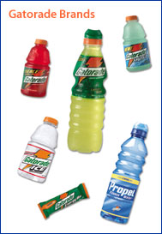
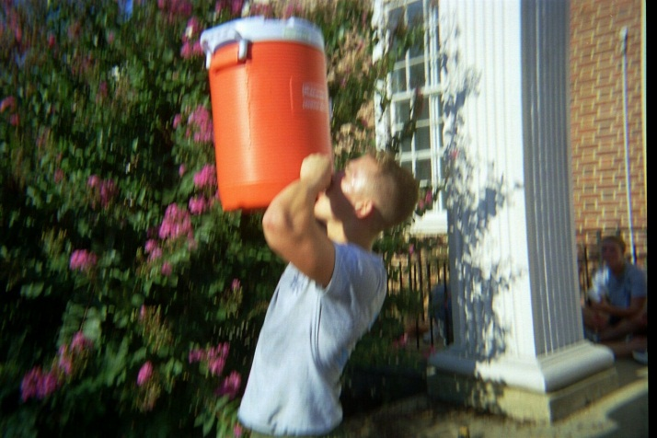
Electrolytes in the Body
Carry messages to and from the brain as electrical signals
Maintain cellular function with the correct concentrations electrolytes
Make your own
50-70 g sugar One liter of warm water Pinch of salt 200ml of sugar free fruit squash Mix, cool and drink

Slide 21
Post-assessment
What are the parts of a solution?

Slide 22
Post-assessment
What are the parts of a solution?
A solution is made of 2 parts: solute and solvent. There may be more than one kind of solute.

Slide 23
Post-assessment
What does “like dissolves like” mean?

Slide 24
Post-assessment
What does “like dissolves like” mean?
"Like dissolves like" refers to the fact that solvents can only dissolve solutes of "like" or the same polarity. For example, a nonpolar solvent will dissolve non-polar solutes but cannot dissolve polar solutes.

Slide 25
Post-assessment
What is the difference in the way molecular and ionic substances dissolve?

Slide 26
Post-assessment
What is the difference in the way molecular and ionic substances dissolve?
The bonds within a molecular solute stay together when dissolved, the solvent only surrounds the molecule instead of separating its atoms. A solvent separates an ionic solute into its component ions when an ionic substance dissolves.

Slide 27
Post-assessment
How is conductivity different for NaCl and MgCl₂ solutions?

Slide 28
Post-assessment
How is conductivity different for NaCl and MgCl₂ solutions?
NaCl dissociates into 2 moles of ions in solution while MgCl₂ dissociates into 3 moles of ions, so you would expect MgCl₂ to have greater conductivity.

