Slide 1
T = Take Notes
I = Interact with your notes
P = Practice with plenty of repetition
S = Self-test

Slide 2
Chapter 12: Sections 3: Concetration of Solutions

Slide 3
Essential questions
What does molarity measure?
How many different ways, or what kinds of units can you use to express concentration?
How are concentration and light absorbance of a solution related?

Slide 4
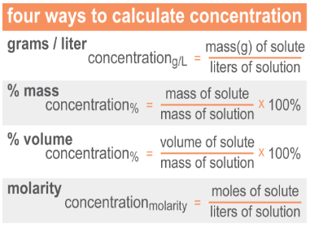
Concentration
Common ways to measure concentration are: grams per liter, percent and molarity.
Grams per liter is a ratio of grams solute per volume if solution in liters (g/L).
Percent concentration is a ratio of solute quantity to solution quantity (either by mass or by volume, but units must cancel).
Molarity is a concentration expressed with moles of solute per liter of solution (M).

Slide 5
Molarity of a solution
The molarity (M) of a solution is the number of moles of solute per liter of solution.
Molarity helps chemists know the ratios and numbers of particles in solutions.

Slide 6
Solved problem
5.50 g of acetic acid (HCH₃COO) are added to 100.0 mL of water. What is the molarity of the solution?
Relationships
Solve |  | First, convert the acetic acid mass to moles. The formula mass of the HCH₃COO solute is 60.05 g/mol. Convert the volume of water to liters: 100.0 mL = 0.1000 L. Now use moles of the solute to calculate solution molarity.
Answer |  | The solution's concentration is 0.916 M HCH₃COO.

Slide 7
Solved problem
How much 0.5 M ammonia remover solution (NaHOCH₂SO₃) should you add to a fish tank in order to completely react with 0.01 mole of ammonia (NH₃)? Balanced reaction: NH₃ + NaHOCH₂SO₃ → NaH₂NCH₂SO₃ + H₂O
Relationships
Solve |  | Use stoichiometry to determine moles of NaHOCH₂SO₃ needed based on the amount of ammonia present. Use the mole ratio from the balanced reaction to convert moles of ammonia to moles of NaHOCH₂SO₃. Rearrange the concentration formula to find the required volume of 0.5 M NaHOCH₂SO₃ solution.
Answer |  | You need to add 20 mL of ammonia remover solution to react with 0.01 moles of ammonia (NH₃) in the fish tank.

Slide 8
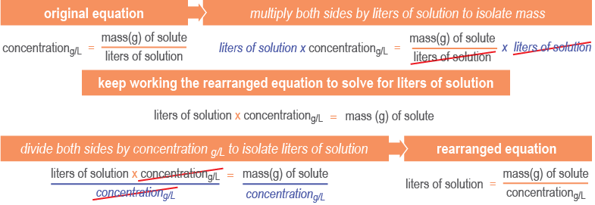
More solution calculations
Frequently you will need to rearrange each of the concentration formulas to solve for the desired quantity.

Slide 9
Solved problem
If the concentration of a salt solution is 50.0 g/L, how much solution do you need if you want 10.0 g of salt?
Given | 10.0 grams of solute and a solution concentration of 50.0 g/L
Relationships | Use the concentration and mass to find volume needed.
Solve
Answer | You would need 0.200 L of salt solution to get 10.0 g of salt.

Slide 10
Other Concentration Units
MOLALITY, m
mol solute
m of solution
=
kilograms solvent
Mass percent of solute
grams solute x 100
grams solution
% by mass =

Slide 11
Calculating Concentrations
Dissolve 62.1 g (1.00 mol) of ethylene glycol in 250. g of H₂O. Calculate molality and % by mass of ethylene glycol.

Slide 12
Calculating Concentrations
Dissolve 62.1 g (1.00 mol) of ethylene glycol in 250. g of H₂O. Calculate m & % of ethylene glycol (by mass).
Calculate molality
Calculate weight %

Slide 13
Solved problem
If you dissolve 5.0 g of salt in 30.0 g of water, what is the mass percent concentration of salt in the solution?
Relationships | Solution = solute + solvent; % concentration = (solute/solution) x 100
Solve | The % mass equation needs the mass of solution. A solution is made of a solvent and its solutes: Solution = Solvent + Solute(s) This solution totals 35.0 g. Now solve for % mass:
Answer | The sugar solution concentration is 14%.

Slide 14
Solved problem
The fluid in an intravenous (IV) bag contains a 0.90% NaCl solution. If you need to supply 5.0 kg of solution for a hospital, what mass of NaCl do you need?
Given | 5.0 kg of IV solution, solute concentration of 0.90%
Relationships | Rearrange the % concentration by mass formula as shown above.
Solve
Answer | You would need 45 g NaCl to make 5.0 kg of IV fluid.

Slide 15
Working with very dilute solutions
Parts per million (ppm) and parts per billion (ppb) are used to describe small concentrations of solutes.
Water quality scientists monitor substances at these small concentrations that impact the safety of drinking water.

Slide 16
Parts per Million (ppm) solute= mass of solute x 10⁶
total mass of solution
Parts per Billion (ppb) solute = mass of solute x 10⁹
total mass of solution
Example: A 2.5 g sample of groundwater was found to contain .00054 grams of Zn^{2+.} What is the concentration of Zn²⁺ in parts per million? In parts per billion?

Slide 17
Solved problem
Scientists have determined that a lead concentration in drinking water at or above 15 ppb is unsafe. Analysis of a drinking water sample shows there are 2.10 μg lead dissolved per 1.50 liters water. Is the water safe to drink?
Asked | Is the drinking water below the limit of 15 ppb?
Given | 2.10 μg lead solute, 1.50 L solution
Relationships | The best equation to use is:
Solve
Answer | Yes, the water is safe to drink because 1.40 ppb is well below the limit of 15 ppb

Slide 18
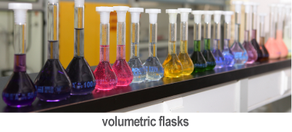
Preparing a solution from a solid solute
Find the formula mass of the solute to be dissolved.
Use the formula mass to calculate the grams of solute needed. Multiply the required moles by the formula mass to get grams of solute needed.
Measure the required grams of solute.
Add the solute to a volumetric flask like the ones shown above.
Fill the volumetric flask about two-thirds with distilled water.
Cap and invert the flask several times until all of the solid dissolves.
Fill the volumetric flask with distilled water up to the correct volume mark. You may need a pipette to get the meniscus right on the line.
Cap and invert the flask several times to ensure complete mixing.

Slide 19
Solved problem
Your experiment calls for 250.0 mL of a 1.5 M NaHCO₃ solution. How much solute and solvent do you need to mix to form the solution?
Given | 250.0 mL of solution needed, 1.5 M solution concentration
Solve | First, use molarity and volume to determine the number of moles solute. Then convert moles to grams. Find the moles of NaHCO₃ needed: Convert to grams: Round the answer: 31.5026 g = 32 g
Answer | You will need to dissolve 32 g NaHCO₃ in enough distilled water to form 250.0 mL solution.

Slide 20
Dilution: Preparing a solution from an existing solution
Identify the molarity of the concentrated stock solution (M₁) and the molarity you need for the new solution (M₂).
Decide how much of the new, dilute solution you will need. This is final volume (V₂).
Use the dilution formula: M₁ × V₁ = M₂ × V₂ to determine how much original, concentrated solution you need. Solve for the initial volume of concentrated solution (V₁).
The difference between the final volume (V₂) and the initial volume (V₁) equals the amount of distilled water you’ll need to add to the final solution: V_{water} = V₂ – V₁

Slide 21
Solved problem
Your experiment calls for 50.0 mL of a 0.10 M NiCl₂ solution. How much 1.00 M NiCl₂stock solution and how much distilled water do you need to mix to make the solution?
Given | M₁, M₂ and V₂
Solve | First, find the volume of stock solution needed. Next, solve for water needed: V_{water} = V₂ – V₁ V_{water} = 500. mL – 200. mL = 300. mL
Answer | You need to mix 200. mL CaCl₂ stock solution with 300. mL distilled water.

Slide 22
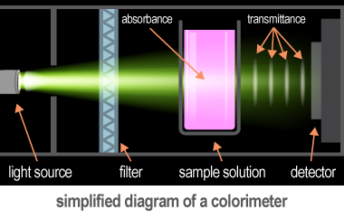
Using color to measure concentration
A colorimeter uses the intensity of colored light shined through a colored solution to measure its concentration.
Absorbance is the amount of light absorbed by a solution.
Transmittance is the amount of light that passes through a solution.
Beer's law, states that absorbance and concentration are directly proportional.

Slide 23
Post-assessment
What does molarity measure?

Slide 24
Post-assessment
What does molarity measure?
Molarity is an expression of concentration in moles solute per liter solution.

Slide 25
Post-assessment
How many different ways, or what kinds of units can you use to express concentration?

Slide 26
Post-assessment
How many different ways, or what kinds of units can you use to express concentration?
Some of the ways to express concentration include percent volume, percent mass, grams per liter, molarity, ppm, and ppb.

Slide 27
Post-assessment
How are concentration and light absorbance of a solution related?

Slide 28
Post-assessment
How are concentration and light absorbance of a solution related?
There is a direct relationship between concentration and light absorbance, that is, a high concentration results in high light absorbance and a low concentration results in low light absorbance.

