Slide 1
T = Take Notes
I = Interact with your notes
P = Practice with plenty of repetition
S = Self-test

Slide 2
Chapter 3: Section 2: Atomic structure

Slide 3
Essential questions
How big is an atom?
What are some ways elements are organized on the periodic table?

Slide 4
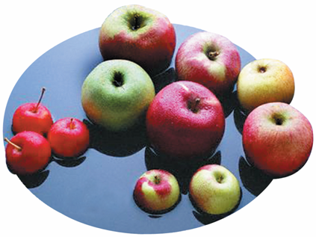
Distinguishing atoms
Just as apples come in different varieties, a chemical element can come in different “varieties” called isotopes.

Slide 5
Early models of the atom
Atomic Number
What makes one element different from another?
Elements are different because they contain different numbers of protons.
The atomic number of an element is the number of protons in an atom. It is also the number of electrons.

Slide 6
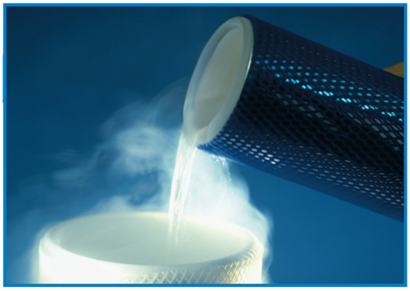
Atomic number

Slide 7
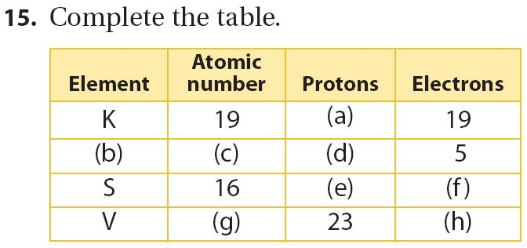
practice

Slide 8
Mass number
Mass Number
How do you find the mass number of an atom?
The mass number is the total number of protons and neutrons in an atom.
Mass number = protons + neutrons
Neutrons = mass number - protons

Slide 9
Practice

Slide 10
Neutrons

Slide 11
isotopes
Isotopes
How do isotopes of an element differ?
Isotopes are atoms that have the same number of protons but different numbers of neutrons.
Because isotopes of an element have different numbers of neutrons, they also have different mass numbers.

Slide 12
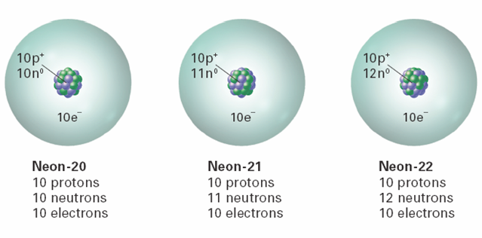
isotopes
Despite these differences, isotopes are chemically alike because they have identical numbers of protons and electrons.

Slide 13
practice

Slide 14
Post-assessment
What is the difference between the macro and micro scale?

Slide 15
Post-assessment
What is the difference between the macro and micro scale?
The macroscopic scale is visible without any special tools needed. The microscopic scale is too small to see.

Slide 16
Post-assessment
How big is an atom?

Slide 17
Post-assessment
How big is an atom?
Atoms are on the microscopic scale, but far smaller than microorganisms like bacteria.

