Slide 1
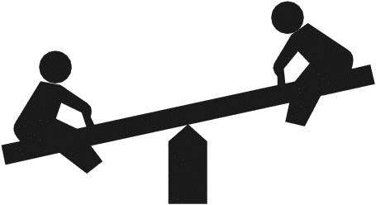
Equilibrium and Le Chatelier’s Principle

Slide 2
CA Standards
Students know how to use LeChatelier’s principle to predict the effect of changes in concentration, temperature, and pressure.
Students know equilibrium is established when forward and reverse reaction rates are equal.

Slide 3
Chemical Equilibrium
Reversible Reactions:
A chemical reaction in which the products
can react to re-form the reactants
Chemical Equilibrium:
When the rate of the forward reaction
equals the rate of the reverse reaction
and the concentration of products and
reactants remains unchanged
2HgO(s)  2Hg(l) + O₂(g)
Arrows going both directions (  ) indicates equilibrium in a chemical equation

Slide 4
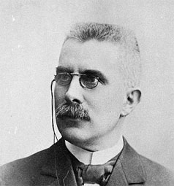
LeChatelier’s Principle
When a system at
equilibrium is placed under
stress, the system will
undergo a change in such
a way as to relieve that
stress.
Henry Le Chatelier

Slide 5
Le Chatelier Translated:
When you take something away from a system at equilibrium, the system shifts in such a way as to replace what you’ve taken away.
When you add something to a system at equilibrium, the system shifts in such a way as to use up what you’ve added.

Slide 6
LeChatelier Example #1
A closed container of ice and water at equilibrium. The temperature is raised.
Ice + Energy  Water
The equilibrium of the system shifts to the _______ to use up the added energy.
right

Slide 7
LeChatelier Example #2
A closed container of N₂O₄ and NO₂ at equilibrium. NO₂ is added to the container.
N₂O₄ (g) + Energy  2 NO₂ (g)
The equilibrium of the system shifts to the _______ to use up the added NO₂.
left

Slide 8
LeChatelier Example #3
A closed container of water and its vapor at equilibrium. Vapor is removed from the system.
water + Energy  vapor
The equilibrium of the system shifts to the _______ to replace the vapor.
right

Slide 9
LeChatelier Example #4
A closed container of N₂O₄ and NO₂ at equilibrium. The pressure is increased.
N₂O₄ (g) + Energy  2 NO₂ (g)
The equilibrium of the system shifts to the _______ to lower the pressure, because there are fewer moles of gas on that side of the equation.
left

